Slide 1
VOn Recklinghausen's Neurofibromatosis
A PowerPoint presentation by Morgan Laurio on NF 1

Slide 2
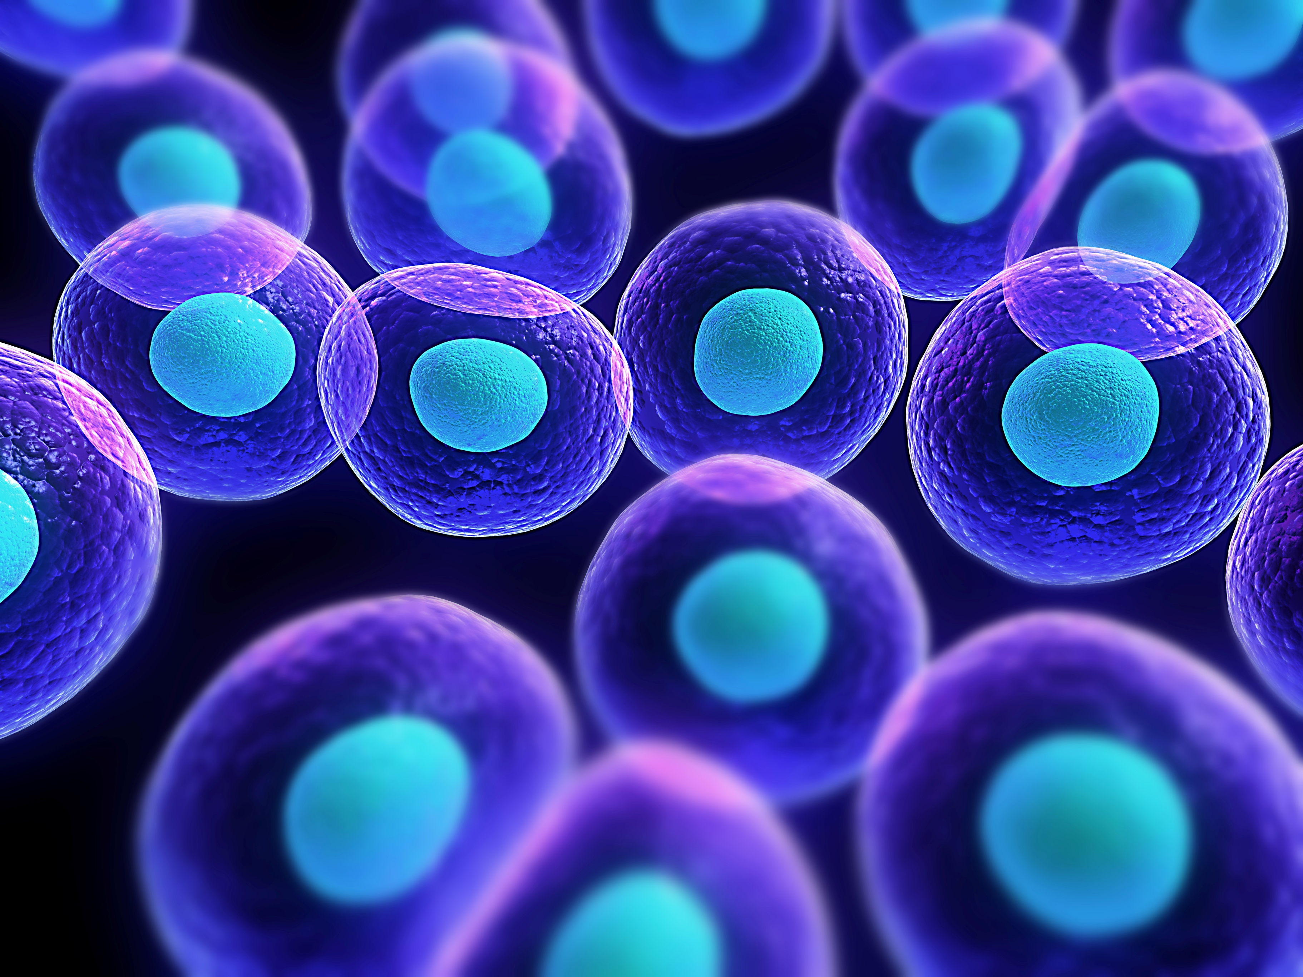
Definition
Neurofibromatosis is a genetic disorder that disturbs cell growth in your nervous system, causing tumors to form on nerve tissue

Slide 3
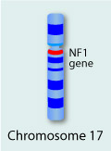
Cause
Autosomal dominant disease
Genetic Disorder
Not a sex-linked gene
Not non-disjunction
It is inherited from a parent or occur spontaneously at conception
The gene produces a protein called neurofibromin
The gene is located on chromosome 17

Slide 4
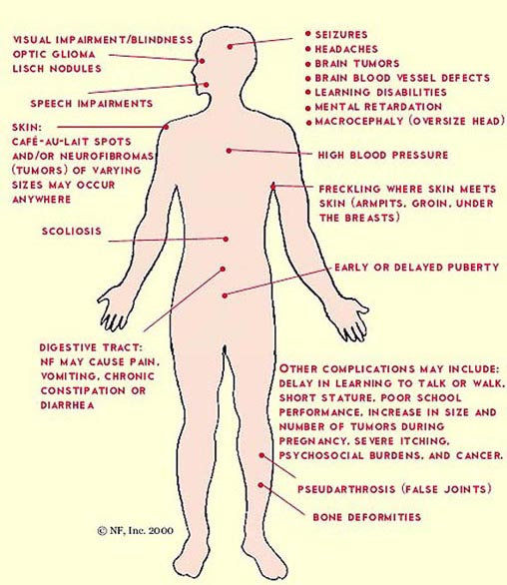
Facts About NF
NF 1 occurs in every 1 in 3,000 births
There is no sex or racial predilection
NF 1 occurs from birth; symptoms show up from the birth

Slide 5
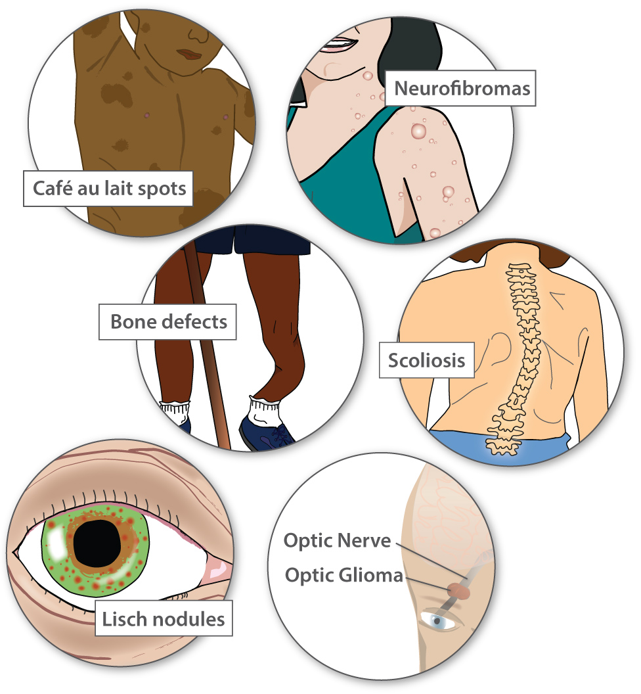
Symptoms
Café au lait spots
Freckling in the armpits and/or groin area
Soft bumps on or under skin
Tiny bumps on the iris of your eye
Bone deformities
Learning disabilities
Larger than average head size
Short stature

Slide 6
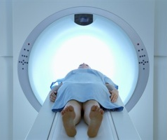
Testing and screening
Physical examination of medical history
Eye exam
Ear exam
Imaging tests
Genetic tests

Slide 7
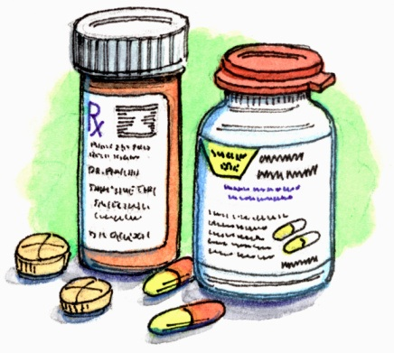
Treatment
There is no cure for NF
Medication is given for pain
Surgeries are used to remove part or all of the tumors. The surgeries might relieve symptoms.

Slide 8
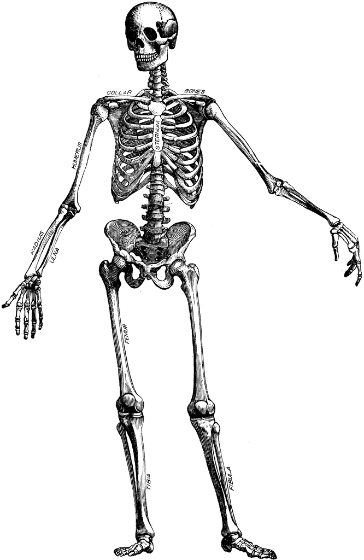
Not fun, interesting Facts
Less than 10% of people with NF 1 develop cancerous tumors
People with NF 1 have an increased risk of cardiovascular problems like high blood pressure

Slide 9
Sources
http://www.mayoclinic.org/diseases-conditions/neurofibromatosis/basics/treatment/con-20027728?utm_source=Google&utm_medium=abstract&utm_content=Neurofibromatosis&utm_campaign=Knowledge-panel
http://www.ncbi.nlm.nih.gov/pmc/articles/PMC3491339/

